Slide 1
Big O or Big Oh! Rough estimate of execution time and memory required but only for comparing algorithms.
Kurt Friedrich
Spring 2017

Slide 2
Program Performance
Big O
Profilers:
which methods
are chewing up
all the time
Which
algorithms
will we use?
Requirements
Architecture
Implementation
Final System Tests
Project Life Cycle

Slide 3










How would you describe and compare the speed of:
A human
Human on a bicycle
Car
Airplane
Bullet fired from rifle

Slide 4
2000
Bullet
Speed in Miles Per Hour
1000
Airplane
Car
Bicycle
Walker
1s 10s 100s 16.6m 2.7 hours

Slide 5
Which one is “best”, for what?
How much “work” can it do (e.g. transport cargo or people)
How long does it take before it operates at nominal performance?
How long can it sustain its nominal performance
What is the cost per mile?
If you gave one of them a 5 second head start, would it change the analysis?
If you “improved” one of them by 20%, would it change the analysis?

Slide 6
Want a way to compare different algorithms
Which one is faster? Which one takes up less space in memory?
Want to compare algorithms early in the process of creating software – preferably before much software has been written
Don't want the metrics to depend on 'incidental' stuff that will change.
(a new version of the compiler was released, new CPU from 3.8 to 4.2 GHz
We're looking for general guidance that we can reuse repeatedly, without having to re-run all our measurements every time something changes
But moving to a system with very different fundamental capabilities might require rethinking the decision
GPU, FPU, 1 core to 16 cores

Slide 7
Want estimate of time / memory needed to run an algorithm as a function of the size of the input
Its ok to measure things in an approximate fashion, we are not predicting the actual performance, but rather, which of 2 algorithms will be faster.
Assuming that our comparisons only hold true for fairly large numbers of input values
For example, if you're only got 10 elements in an array, BubbleSort might actually run faster than QuickSort. But for 10 million elements, a good QuickSort wins by a lot!
Want a mathematically rigorous definition of these metrics, so that we might prove that a given algorithm has certain properties.

Slide 8
compare the asymptotes of two functions
Technically, we want to compare the asymptotes of two functions that model the algorithm execution.
But when you talk about asymptotes, you want to compare the asymptotes of each algorithm's dominant term, WITHOUT any coefficients on that term. Which is where the 'Big "Oh" Notation' comes in – we will drop any non-dominant terms and/or coefficients.
Note we also do not factor in “best case” or even average case. If you have to walk an array to find one value, we assume the one you want is in the last spot, and not on-average, about midpoint.

Slide 9
example
Assume an array with 300 values, sorted from lowest to highest. You've decide to compare two options for finding a particular value in the array: a linear search, and a binary search.
Linear search: Start at the top, and walk thru the entire list, examining each element in the array.

Slide 10
Function for a Linear Search
Assume somehow you know that if there are N elements in the array, that the function describing the number of steps (C# statements, CPU instructions, or whatever else you wanted to call a 'step' in the algorithm) would be:
170 steps to set up the loop, and then about 3.2 steps for each loop to move to the next array element, and do a compare
For our purposes, we can assume that each “step” takes the same amount of time, so then the time required is:

Slide 11
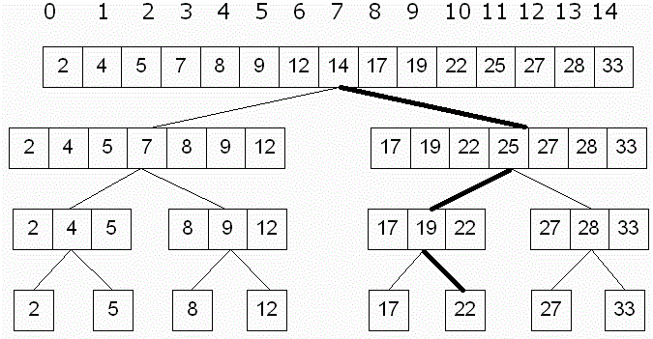
Binary Search
15 element array, asking is 22 in the array?
14 < 22 go to right half
25 > 22 go to left half
19 < 22 go to right half
Found it, or, there is
no more ½, so we are
done.

Slide 12
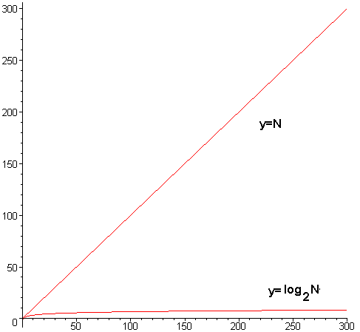
Function for a Binary Search
Assume you know that the time required by the algorithm is
Plotting these two functions (orange):
+170

Slide 13
Function for a Binary Search
Changing the “slope” changes the steepness of the line, but not it’s basic shape.
Y= 1.2N
Y= .8N
+170

Slide 14
Big Oh simplification
Given the incredible difference between those two functions, especially for larger values of N, the coefficients / non-dominant terms don't really matter.
We'd get basically the same graph if we graphed y = N vs. y = log₂N (previous red)
The 'Big Oh Notation' allows us to (in a mathematically rigorous way, that's outside the scope of this class), ignore all the coefficients / non-dominant terms

Slide 15
Most of us do not have BA in Math degrees!
Luckily there's typically only about 6 that we need to consider, and the choice between them is usually pretty clear.
You do need to think about them and understand the math for these 6, and then you can likely successfully match them.
But first, you need to get some “gut feel” about what means.

Slide 16
log₂(1) | 0
log₂(2) | 1
log₂(3) | 1.58596
log₂(4) | 2
log₂(5) | 2.3219
log₂(6) | 2.5850
log₂(7) | 2.8074
log₂(8) | 3
log₂(9) | 3.1699
log₂(10) | 3.3219
… | …
log₂(65536) | 16
Here are the first 10 values, note while N walks up from 1 to 10, the value walks much more slowly, only up to 3.3219
log₂(N) means the power you have to raise 2 in order to get N. For example,
2² = 4, so log₂(4) is 2 (2 to what power gives 4)
2³ = 8, so log₂(8) = 3 (2 to what power gives 8)
2^{1.58496} is ~3, so log₂(3) is roughly 1.58496
2¹⁶ is log₂(65536) is only 16
log₂(2) = 1 because 2¹ is 2
log₂(1) = 0 because by mathematical convention 2⁰ = 1 (any number to the 0 = 1)
Note that log₂(0) is undefined

Slide 17
Ok, let’s look at the common ones.

Slide 18
O(1) aka Constant Time
No matter how many input elements there are (e.g. array elements), the code will never do more than X steps.
Typically see this in situations wherein you're asked to access a single element of the array
for example, get the first element of the array and return it
it'll take the same amount of time whether there are 10, or 10 million, elements in the array
Examples of Code that run in constant time:
Access a single, known array element, such as: rgNums[10] = 20;
But NOT allocating an new array, that is O(N)
Pretty much all operators - 3 + 2, 8 * 100, …
Calling a function (method) - But not counting how long it takes to execute the function

Slide 19

log₂N run-times whenever you have an algorithm that
repeatedly throws away half of the remaining elements.
Example of Code that run in log base-2 time:
Binary search is a perfect example of this – at each iteration, it ignores ½ of the remaining elements.
Anything similar to binary search, where the remaining set of values that the algorithm needs to deal with is halved at every step/pass of the algorithm.
This is a very desirable Big O, as it means you can process long lists very quickly.
65536 in only 16 cycles!
From a mathematical analysis of the Gilbert–Shannon–Reeds model of random shuffles, the number of times one needs to shuffle an n-card deck of cards, using riffle shuffles, to get a distribution on permutations that is close to uniformly random, is approximately 3/2 log₂ n. This calculation forms the basis for a recommendation that 52-card decks should be shuffled seven times.

Slide 20
O(N) aka Linear Time
Normally occurs whenever you have to access every single element so the time to execute will grow linearly and in direct proportion to the size of the input data set.
Accessing every single element of the array twice ends up being Y = 2N, but since the O() notation allows us to ignore coefficients, it ends up being the same thing as O(N).
or 3N, etc. As long as the number of times we access each element is limited, and unrelated to the number of elements, then we'll end up with a linear runtime. Make N five times bigger, it will take 5 times longer to run.
Example of Code that run in O(N) time:
finding the maximum in an unsorted array (have to look at every element)
printing every single element of an array out.
Any loop that goes from 0 to N where N is a variable.
Array creation & initialization: (Since C# puts a zero or “” into each element, with a loop that goes from 0 to N = length of the array)

Slide 21
This means some aspect of the algorithm has this nice asymintope of log₂N work, but you have to do that nice part over and over, N times
So this is far better that O(N²), but much slower than a nice log₂N
Example of Code that run in
We'll see this later on with QuickSort.

Slide 22
It indicates the algorithm will have to go through every single one of the N elements in the array, not just once, but go through all N of them N times each!
If array was length 5, you would look at all 5 cells, 5 times each => 5 * 5 = 25, or 5²
Example of Code that run in N²:
BubbleSort (see code below), SelectionSort, etc
Which are both examples of nested loops, where BOTH the outer AND the inner loop goes from 0 to N.
for (int i = 0; i < array.Length; i++) { for (int j = 1; j < array.Length; j++) { // if they're out of order, // swap them if (array[j - 1] > array[j]) { int temp = array[j]; array[j] = array[j - 1]; array[j - 1] = temp; } } }

Slide 23
O(2^{N}) aka Exponential Growth
The number of steps will double with each additional element in the input data set. The execution time of an O(2^{N}) function will quickly become very large.
Common for artificial intelligence tasks and is really quite bad. Exponential-time algorithms begin to run the risk of having a decent-sized input not finish before the person wanting the result retires.(https://crsr.net/Notes/BigO.html)

Slide 24
O(2^{N}) aka Exponential Growth
When the creator of the game of chess in India showed it to the king, the king gave the creator the right to name his prize. The man asked the king this:
that for the first square of the chess board, he would receive 1 grain of rice
2 for the second one
4 on the third one, etc. for each square on the chess board, doubling the amount each time.
The ruler thought that sounded like a trifle, and agreed
It took the king’s treasurer a week to calculate the amount of wheat, and explained that it would take more than all the assets of the kingdom to give the inventor the reward.
The story ends with the inventor being beheaded.

Slide 25
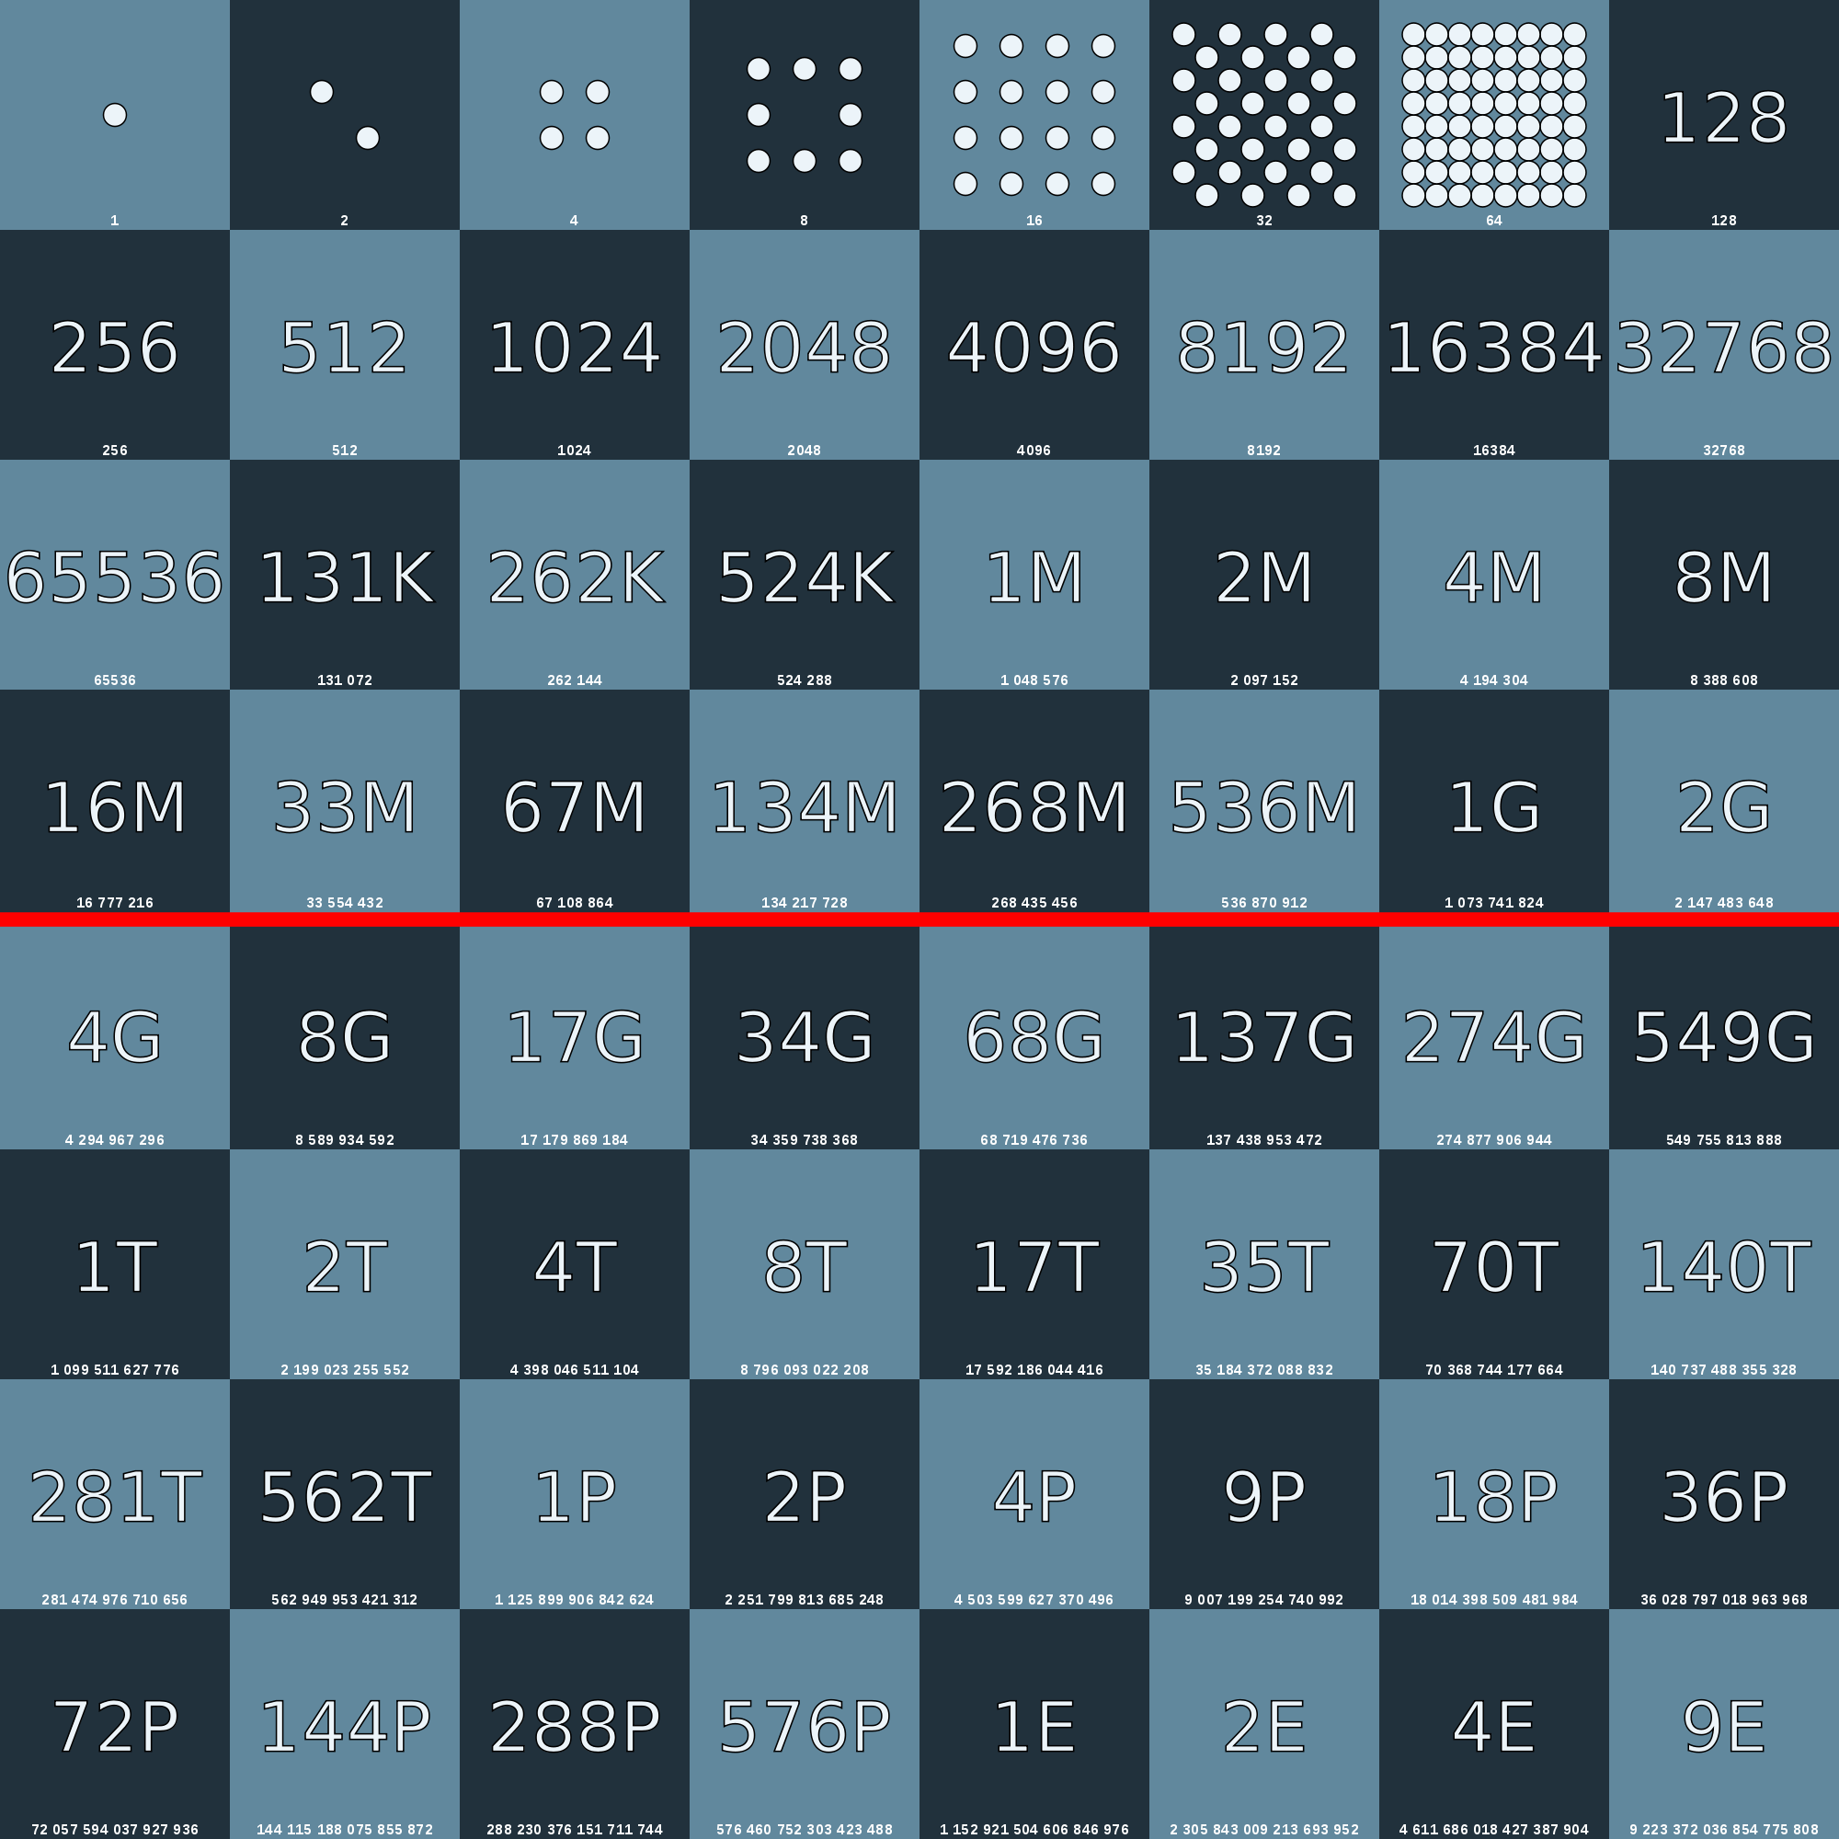
18,000,000,000,000,000,000 grains of rice: about 210 billion tons

Slide 26
O(N!) aka Factorial
The Travelling Salesman, a famous problem in computer science
Supposed there are N towns, each of which is linked to 1 or more other towns by a road of a certain distance. The Travelling Salesman problem is to find the shortest tour that gets the salesmen to every town.
If you have 3 towns A, B and C with roads connection all of them directly to all of them, the sales person could go any of 6 routes
A -> B -> C
A -> C -> B
B -> C -> A
B -> A -> C
C -> A -> B
C -> B -> A
But there are only 3 unique ones, as some are the same as others, just in reverse).
What if there are 4 towns? Then there are 12 unique routes
5 towns gets 60 different routes, can you see this is N! ?
By the time you get to 200 towns there isn't enough time left in the universe to solve the problem with traditional computers.

Slide 27
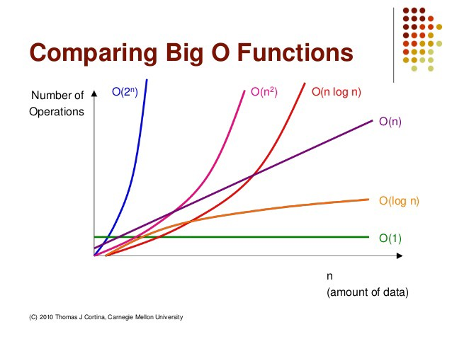
Nice summary
http://bigocheatsheet.com/

